Slide 1

SUSTAINABLE PURCHASING
Toolbox
TISON Audrey
Louvain School of Management
29.05.19

Slide 2

INTRODUCTION

Slide 3








01 - The importance of sustainable purchasing
05 – “assessment” & “reporting” tools
This first section explains the importance of sustainable purchasing in the Chemistry sector and all its advantages
Third Step: Measure and report.
This section gives examples of sustainable KPIs and provides reporting tools and guidelines.
02 – FACT SHEETS
06 – SUCCESS FACTORS
This section provides information in the form of fact sheets on major concepts around sustainable purchasing (CSR, circular economy, etc.)
It is dedicated to beginners.
Following a program step by step will not be sufficient to be successful. Companies have to prioritize collaboration and transparency.
Toolbox’s Contents
03 – “FOuNDATION” TOOLS
07 – OTHER LINKS
First Step: Commit, conceive and assess. These tools are useful for companies that don't know where to start. This section provides reference and evaluation tools to develop policies, assess current sustainable performance and design a sustainable procurement program.
There are a large number of sites and organizations that address the issue of sustainable development and its implementation in corporate purchasing strategies. This sections provides other interesting links.
08 – suggestion box
04 – “IMPLEMENTATION” TOOLs
Second Step: Define and implement.
This step covers two approaches: minimizing the negative impact and opening up to regenerative processes. The first one guides companies in the selection, monitoring and development of suppliers. The second one provides tools related to circular business models.
Collaboration and information sharing are the key to moving towards a more sustainable business world. This is why it could be interesting to provide a section where companies could share good practices and other information about their sustainable purchasing program.

Slide 4
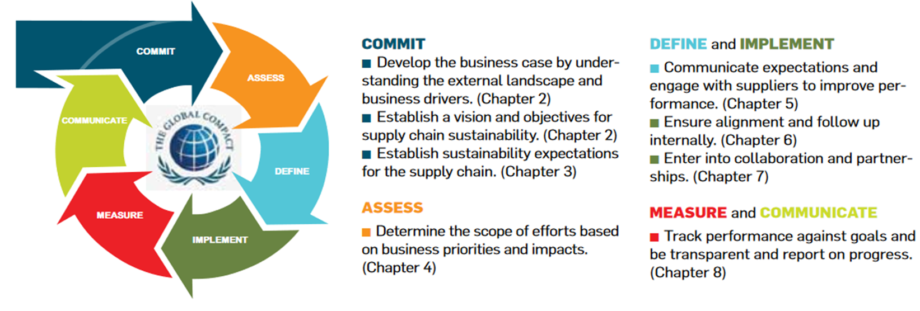
Introduction
The importance of sustainable purchasing
Fact Sheets
« Foundation » Tools
« Implementati-on » Tools
« Assessment » & « Reporting » Tools
Success factors
Other links
Suggestion box
UN Global Compact, BSR. 2010. Supply chain sustainability : a practical Guide for Continuous improvement.

Slide 5
Introduction
The importance of sustainable purchasing
Fact Sheets
« Foundation » Tools
« Implementati-on » Tools
« Assessment » & « Reporting » Tools
Success factors
Other links
Suggestion box
Definitions
Helping organizations
Guides
Fact Sheets
« Foundation » Tools
« Implementation » Tools
« Assessment » and « Reporting » Tools
Level 0
DISCOVER
SAQ questionnaire
Risk Evaluation and materiality matrix
Code of Conduct and other purchasing policies
Balanced Scorecard
Level 1
COMMIT & ASSESS
Supplier monitoring (audits and visits)
Supplier selection (risk assessment, selection criteria,…)
Supplier development (action plans, collab,…)
Product focus (LCA)
Introduction to circular economy
Level 2
DEFINE & IMPLEMENT
Minimizing the negative impact
Going further…
Opening up to circular economy
Reporting guidelines (GRI, …)
Financial indexes about sustainability
KPIs
Examples of reports
Level 3
MEASURE & COMMUNICATE

Slide 6

IMPORTANCE OF
SUSTAINABLE PURCHASING

Slide 7
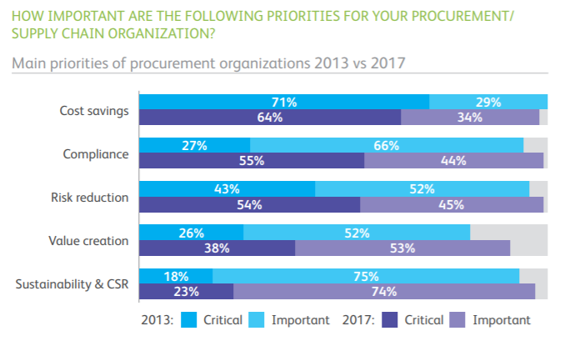
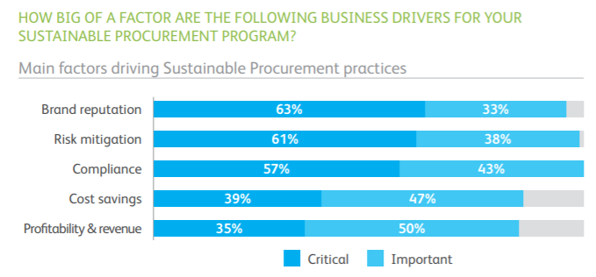
Introduction
The importance of sustainable purchasing
Fact Sheets
« Foundation » Tools
« Implementati-on » Tools
« Assessment » & « Reporting » Tools
Success factors
Other links
Suggestion box
This first section explains the importance of sustainable purchasing in the Chemistry sector and all its advantages
Importance of sustainable purchasing
Ecovadis Barometer-p.7-Main factors driving Sustainable Procurement practices
Ecovadis Barometer - p.6 -Main priorities of procurement organizations

Slide 8
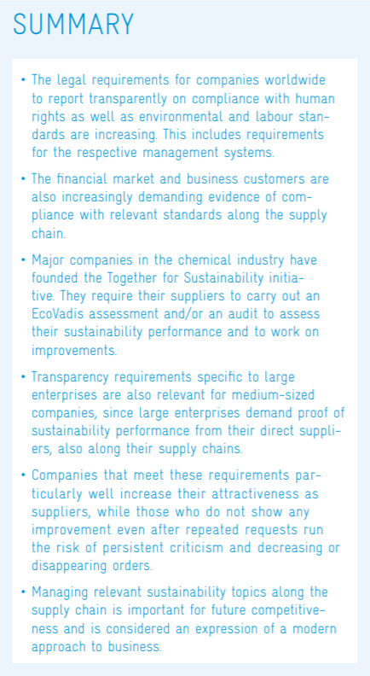
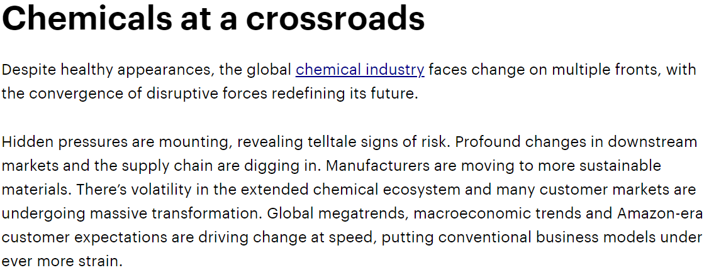
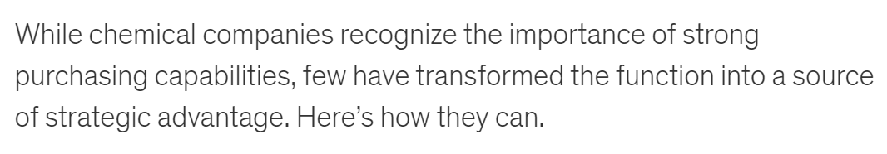
Introduction
The importance of sustainable purchasing
Fact Sheets
« Foundation » Tools
« Implementati-on » Tools
« Assessment » & « Reporting » Tools
Success factors
Other links
Suggestion box
Importance for the chemical sector
Guide Chemie3 p.11
Accenture Chimie
McKinsey - Pursuing purchasing excellence in chemicals

Slide 9
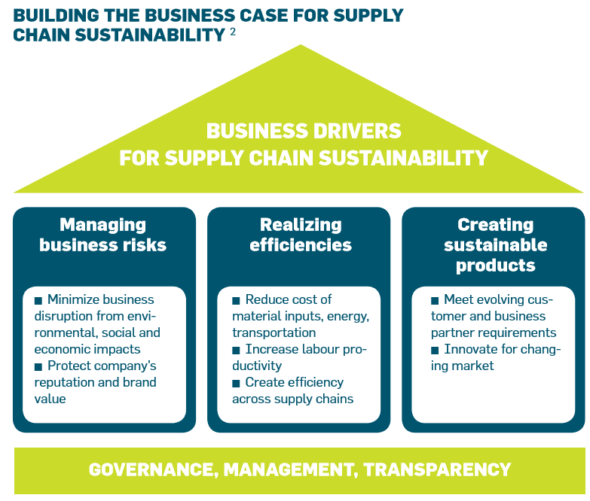
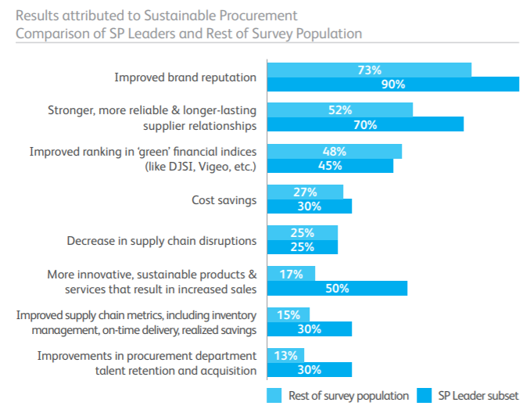
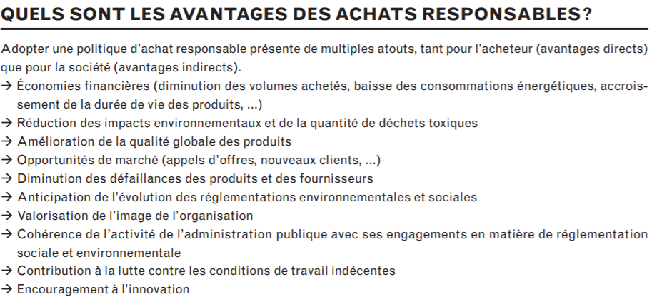
Introduction
The importance of sustainable purchasing
Fact Sheets
« Foundation » Tools
« Implementati-on » Tools
« Assessment » & « Reporting » Tools
Success factors
Other links
Suggestion box
Advantages of sustainable purchasing
UN Global Compact & BSR - Supply Chain Sustainability p.13
Ecovadis Barometer - p.21 –Main advantages of sustainable procurement
Guide des Achats Professionnels Responsables p.2 Avantages

Slide 10

FACT SHEETS

Slide 11

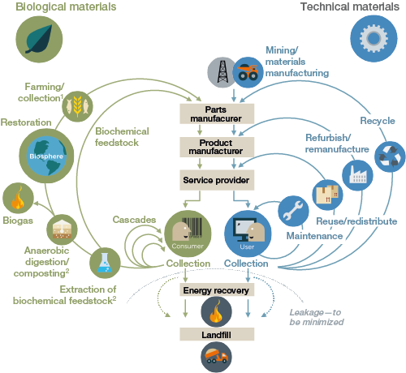
Introduction
The importance of sustainable purchasing
Fact Sheets
« Foundation » Tools
« Implementati-on » Tools
« Assessment » & « Reporting » Tools
Success factors
Other links
Suggestion box
Example of Fact Sheet
Circular Economy
A bit of history
As a result of the 2007 McKinsey study into the next evolution in global socio-economics, the circular economy concept was born into reality and defined as a practice to adopt for global sustainable economic development. In 2009, Dame Ellen MacArthur founded the Ellen MacArthur Foundation (EMF), an organization wholly focused on educating and supporting circular economy efforts worldwide. The EMF has since pioneered education and global implementation of circular economy principles.
Governmenteuropea.eu
What is Circular Economy?
Looking beyond the current take-make-waste extractive industrial model, a circular economy aims to redefine growth, focusing on positive society-wide benefits. It entails gradually decoupling economic activity from the consumption of finite resources, and designing waste out of the system. Underpinned by a transition to renewable energy sources, the circular model builds economic, natural, and social capital. It is based on three principles:
Design out waste and pollution
Keep products and materials in use
Regenerate natural systems
Ellen MacArthur Foundation, 2016
The model
A distinction can be made between the biological and the technical circle. The video explains how do these loops work based on a commonly used model made by the Ellen McArthur Foundation
Advantages of the circular economy
Practical Examples
…
More info?
Ellen MacArthur Foundation Website

Slide 12
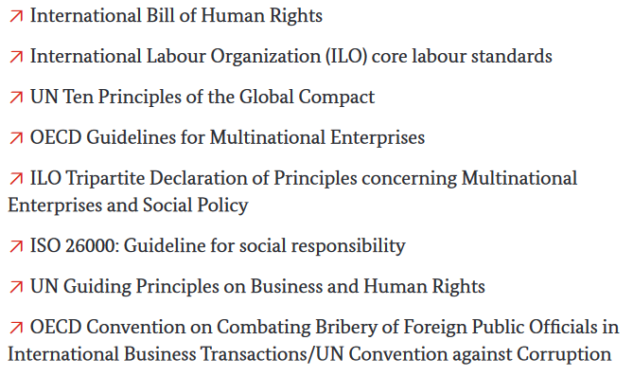
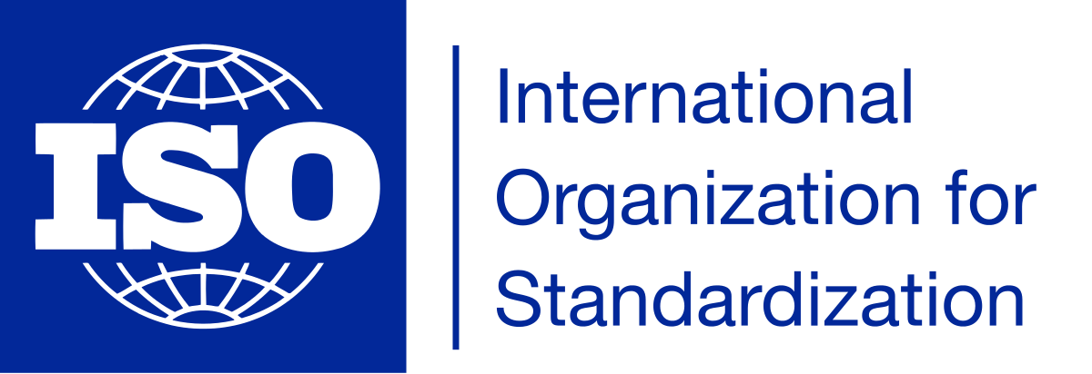




Introduction
The importance of sustainable purchasing
Fact Sheets
« Foundation » Tools
« Implementati-on » Tools
« Assessment » & « Reporting » Tools
Success factors
Other links
Suggestion box
Example of Fact Sheet
International Standards & Guidelines
What is a standard?
A standard (French: Norme, German: Norm) is a technical document designed to be used as a rule, guideline or definition. It is a consensus-built, repeatable way of doing something.
Standards are created by bringing together all interested parties such as manufacturers, consumers and regulators of a particular material, product, process or service. All parties benefit from standardization through increased product safety and quality as well as lower transaction costs and prices European Committee for Standardization
Corporate Social Responsibility and Corporate Purchasing Standards
ISO creates documents that provide requirements, specifications, guidelines or characteristics that can be used consistently to ensure that materials, products, processes and services are fit for their purpose.
More info?
Website ISO
Sustainable Procurement
Social Responsibility
Environmental Management System
Same process for…
OECD: Guidelines for Multinational Companies
UN Sustainable Development Goals (SDGs)
SDGs in Belgium
Global Reporting Initiatives (GRI)
The 10 Principles of Global Compact and their links to supply chain p.8
Labels Labelinfo.be ecolabel.be
EMAS (« Eco Management and Audit Scheme »)
Tool to understand the standards
ITC Sustainability Map

Slide 13
Introduction
The importance of sustainable purchasing
Fact Sheets
« Foundation » Tools
« Implementati-on » Tools
« Assessment » & « Reporting » Tools
Success factors
Other links
Suggestion box
List of concepts to insert in Fact Sheets
Sustainable Development
Corporate Social Responsibility
Social and environmental laws for companies / Conformity
SSCM and Sustainable Purchasing
Responsible Care
Circular Economy
Life Cycle Assessment, etc.
Guide des Achats Professionnels Responsables p.17 Définition
ISO 26000
Europa.eu
UN Global Compact SDGs
Sustainable Development – Belgium.be
What is Sustainable Development?
Mon tableau récapitulatif mais non exhaustif de la législation (par rapport au CSR) AVIS
Corruption Mapping
What is sustainable supply chain management?
Supply Chain Sustianability : A force for a Good
Sustainable Procurement - ECOVADIS
BASF explaining Responsible Care
Responsible Care - CEFIC
Ellen MacArthur Foundation
The 8 Principles of RE
https://www.icca-chem.org/responsible-care/
Other ideas?

Slide 14
Introduction
The importance of sustainable purchasing
Fact Sheets
« Foundation » Tools
« Implementati-on » Tools
« Assessment » & « Reporting » Tools
Success factors
Other links
Suggestion box
Rem: Joindre de brèves explications
ALSO IN FACT SHEETS
List of Helping Organizations
List of Sustainable Purchasing Guides
Accenture Chimie
Together For Sustainability
Ecovadis
Sustainable Development Platform
CSR Europe
CDP - Disclosure Insight Action
SPIRE
Circulab
WBCSD - Program Factor 10 - Circular Economy
Take Back Chemicals
Econsense.de
Ellen MacArthur Foundation
Guide Chemie3
UN Global Compact & BSR - Supply Chain Sustainability
TheShift - Achats Durables - Feuille de route
CSR Compass (recommandé par le PAN)
Guide des Achats Professionnels Responsables - Confédération Suisse
Barometer 2017 Ecovadis - Sustainable Procurement
Moving towards a circular economy with EMAS
WBCSD - Circular Economy Digital Guide (8 case studies and strategies)
WBCSD - CEO Guide to Circular Economy (How companies get started?)
ECONSENSE: Process steps for sustainable supply chain management
BMU - Step-by-step guide to SSCM
IISD’s Business and Sustainable Development Guide

Slide 15

« FOUNDATION »
TOOLS
Les détails pour chaque outil se trouvent dans le Powerpoint « Outils par catégorie »

Slide 16
Introduction
The importance of sustainable purchasing
Fact Sheets
« Foundation » Tools
« Implementati-on » Tools
« Assessment » & « Reporting » Tools
Success factors
Other links
Suggestion box
Commit & Assess
Three topics
Mapping the supply chain: risk and opportunities assessment
Current Sustainability Impact Assessment
Formulating supplier requirements (Code of Conduct, etc) and reporting?

Slide 17











Introduction
The importance of sustainable purchasing
Fact Sheets
« Foundation » Tools
« Implementati-on » Tools
« Assessment » & « Reporting » Tools
Success factors
Other links
Suggestion box
Mapping the supply chain: risk and opportunities assessment
Les détails pour chaque outil se trouvent dans le Powerpoint « Outils par catégorie »

Slide 18




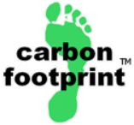
Introduction
The importance of sustainable purchasing
Fact Sheets
« Foundation » Tools
« Implementati-on » Tools
« Assessment » & « Reporting » Tools
Success factors
Other links
Suggestion box
Current Sustainability Impact Assessment

Slide 19
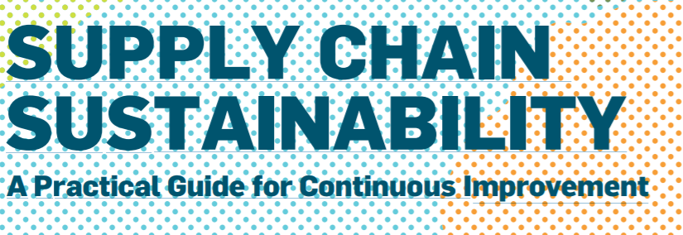




Introduction
The importance of sustainable purchasing
Fact Sheets
« Foundation » Tools
« Implementati-on » Tools
« Assessment » & « Reporting » Tools
Success factors
Other links
Suggestion box
Formulating supplier requirements (CoC, etc) and reporting?

Slide 20

« IMPLEMENTATION »
TOOLS
Les détails pour chaque outil se trouvent dans le Powerpoint « Outils par catégorie »

Slide 21
Introduction
The importance of sustainable purchasing
Fact Sheets
« Foundation » Tools
« Implementati-on » Tools
« Assessment » & « Reporting » Tools
Success factors
Other links
Suggestion box
Level 1 : Minimizing the negative impact
Supplier Focus
Supplier Selection
Supplier Monitoring
Supplier Development
Product Focus
(Life Cycle Assessment)
Level 2 : Opening up to circular business models

Slide 22
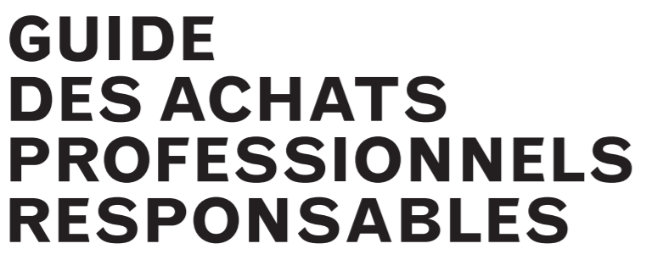
Introduction
The importance of sustainable purchasing
Fact Sheets
« Foundation » Tools
« Implementati-on » Tools
« Assessment » & « Reporting » Tools
Success factors
Other links
Suggestion box
Level 1 : Minimizing the negative impact
Supplier Focus
Supplier Selection

Slide 23



Introduction
The importance of sustainable purchasing
Fact Sheets
« Foundation » Tools
« Implementati-on » Tools
« Assessment » & « Reporting » Tools
Success factors
Other links
Suggestion box
Level 1 : Minimizing the negative impact
Supplier Focus
Supplier Monitoring

Slide 24
Introduction
The importance of sustainable purchasing
Fact Sheets
« Foundation » Tools
« Implementati-on » Tools
« Assessment » & « Reporting » Tools
Success factors
Other links
Suggestion box
Level 1 : Minimizing the negative impact
Supplier Focus
Supplier Development

Slide 25
Introduction
The importance of sustainable purchasing
Fact Sheets
« Foundation » Tools
« Implementati-on » Tools
« Assessment » & « Reporting » Tools
Success factors
Other links
Suggestion box
Level 1 : Minimizing the negative impact
Product Focus
(Life Cycle Assessment)
Organisation | Access | Source
OpenLCA | Free – Need Suscription | http://www.openlca.org/
GaBi Software | Not free | http://www.gabi-software.com/overview/what-is-gabi-software/
Umberto LCA+ | Not free | https://www.ifu.com/en/umberto/lca-software/
SimaPro | Not free | https://simapro.com/
Ecochain | Not free | https://ecochain.com/software/
+

Slide 26






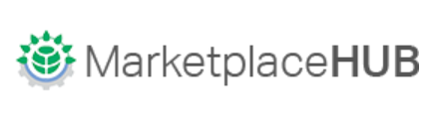
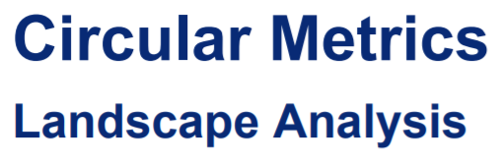


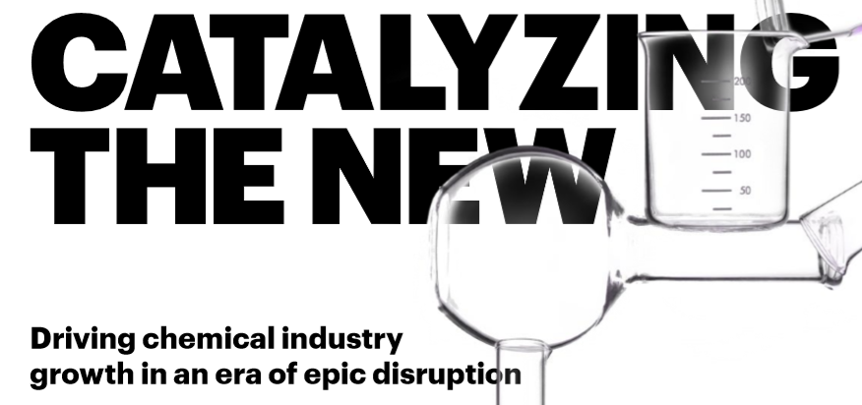
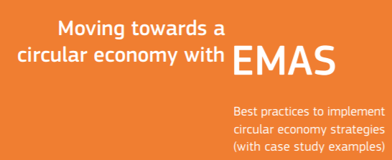


Introduction
The importance of sustainable purchasing
Fact Sheets
« Foundation » Tools
« Implementati-on » Tools
« Assessment » & « Reporting » Tools
Success factors
Other links
Suggestion box
Level 2 : Opening up to circular economy

Slide 27

« ASSESSMENT » and « REPORTING »
TOOLS
Les détails pour chaque outil se trouvent dans le Powerpoint « Outils par catégorie »

Slide 28
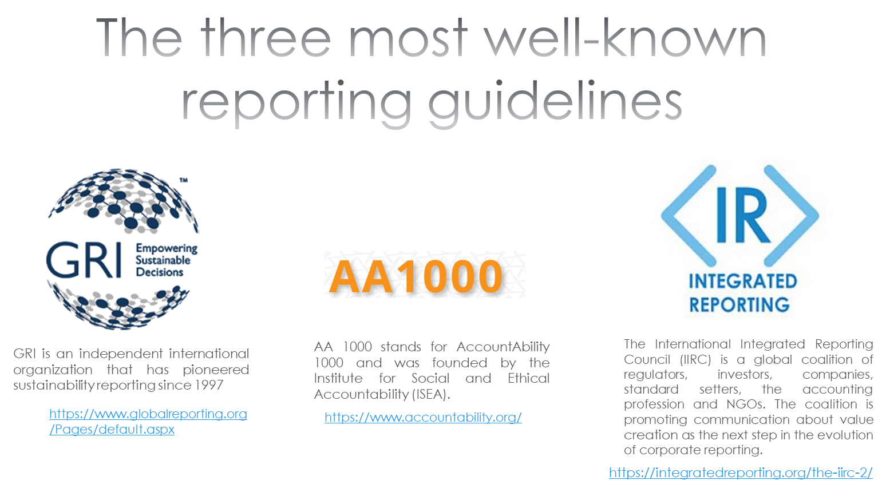




Introduction
The importance of sustainable purchasing
Fact Sheets
« Foundation » Tools
« Implementati-on » Tools
« Assessment » & « Reporting » Tools
Success factors
Other links
Suggestion box

Slide 29

SUCCESS FACTORS

Slide 30
Introduction
The importance of sustainable purchasing
Fact Sheets
« Foundation » Tools
« Implementati-on » Tools
« Assessment » & « Reporting » Tools
Success factors
Other links
Suggestion box
Collaboration
Engagement
Innovation
LT Perspective
Transparency
Systemic Vision

Slide 31

OTHER LINKS

Slide 32
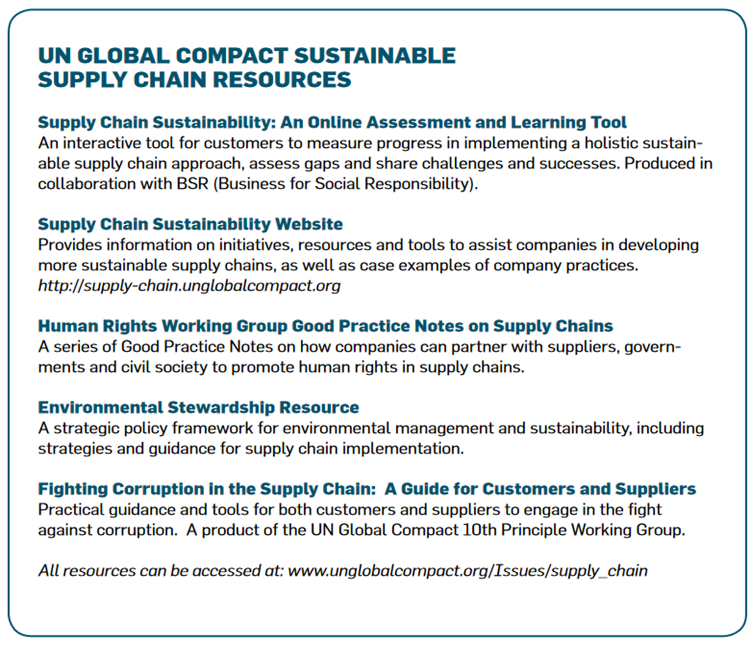
Introduction
The importance of sustainable purchasing
Fact Sheets
« Foundation » Tools
« Implementati-on » Tools
« Assessment » & « Reporting » Tools
Success factors
Other links
Suggestion box

Slide 33
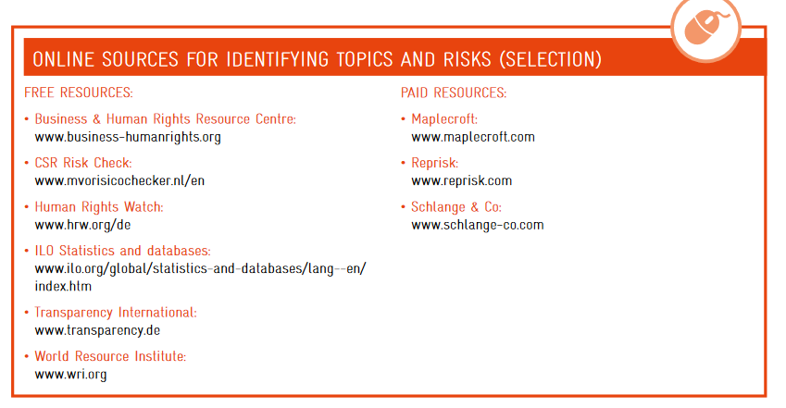
Introduction
The importance of sustainable purchasing
Fact Sheets
« Foundation » Tools
« Implementati-on » Tools
« Assessment » & « Reporting » Tools
Success factors
Other links
Suggestion box

Slide 34
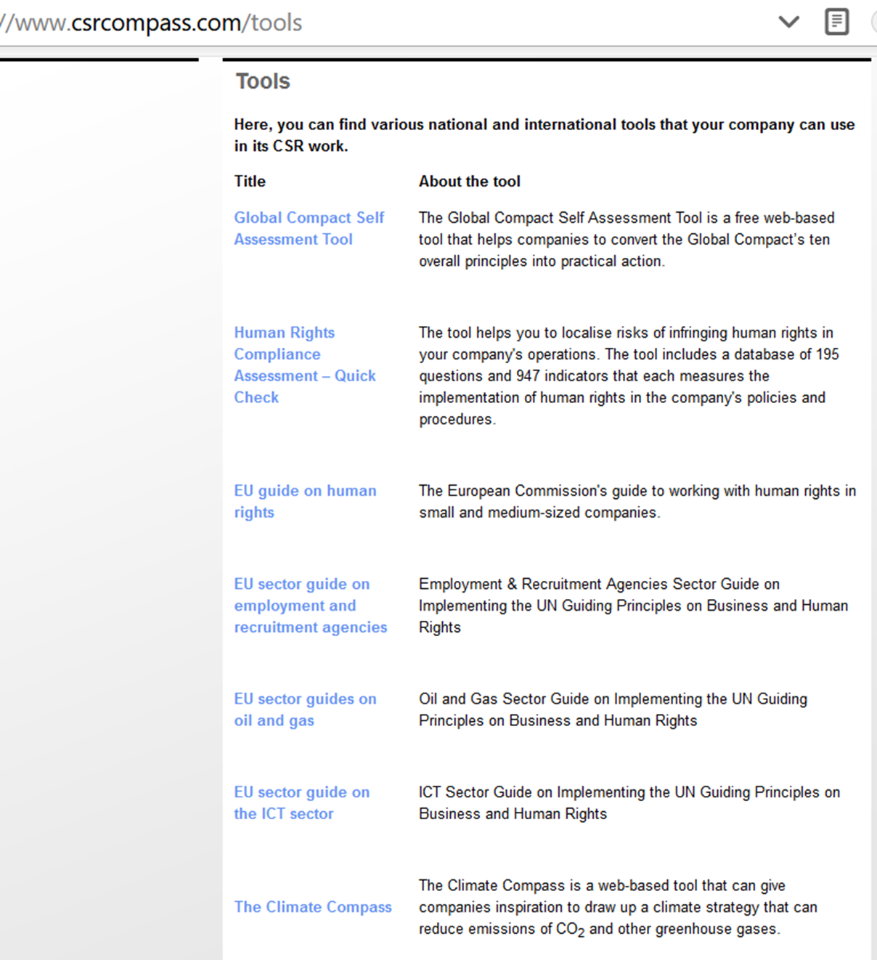
Introduction
The importance of sustainable purchasing
Fact Sheets
« Foundation » Tools
« Implementati-on » Tools
« Assessment » & « Reporting » Tools
Success factors
Other links
Suggestion box

Slide 35
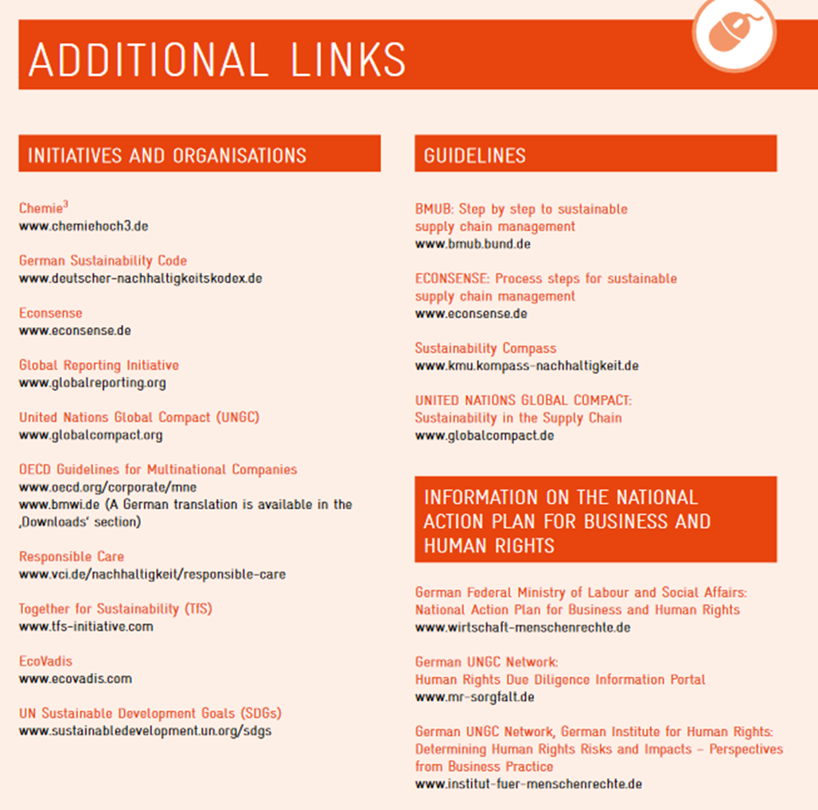
Introduction
The importance of sustainable purchasing
Fact Sheets
« Foundation » Tools
« Implementati-on » Tools
« Assessment » & « Reporting » Tools
Success factors
Other links
Suggestion box

Slide 36
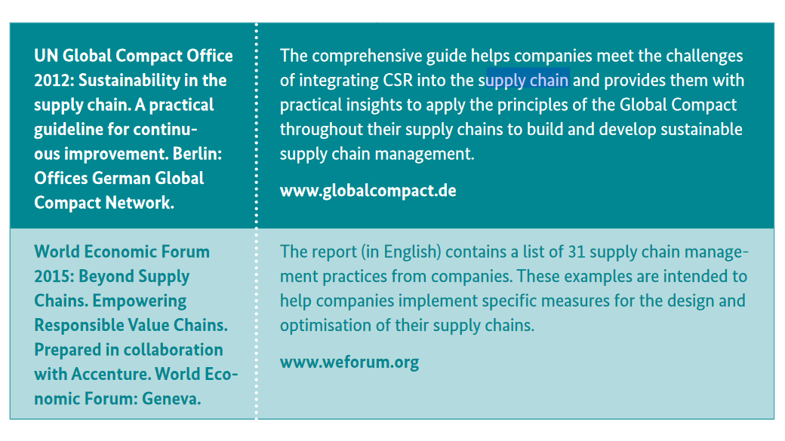
Introduction
The importance of sustainable purchasing
Fact Sheets
« Foundation » Tools
« Implementati-on » Tools
« Assessment » & « Reporting » Tools
Success factors
Other links
Suggestion box

Slide 37

SUGGESTION BOX

